Slide 1
Office 365 Development Overview

Slide 2
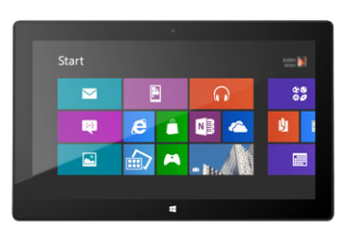
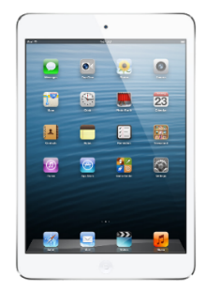


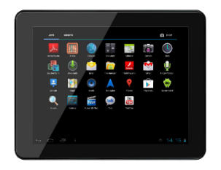
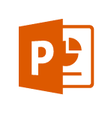
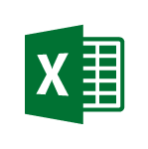
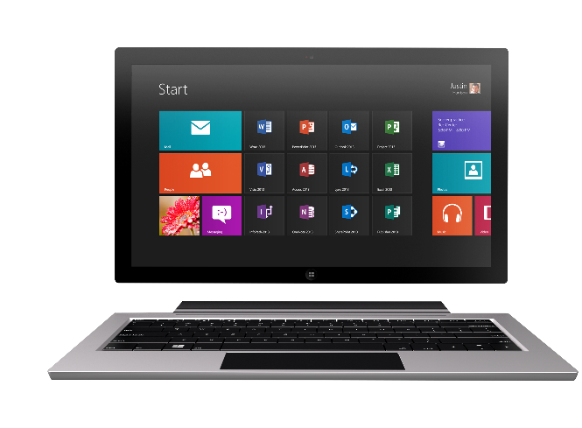
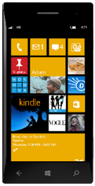
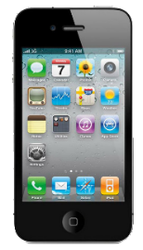
Technology journey
PC
1990s
PC + Servers
2000s
Devices + Cloud
2010s
VBA
VBA
Com add-ins
VSTO
FTC
Open standards
Mobile SDK’s

Slide 3
Office 365 Environment
Office
Exchange
SharePoint
OneDrive for Business
Azure Active Directory (AAD)

Slide 4


Contextual Apps
Your Apps, our UI
Surface your apps in the Office 365 platform
In Context
In context of your business users productivity activities
Reach
In Office Client, Office Online and Modern Apps

Slide 5

Web Standards
Apps are built using industry proven web standards such as HTML, JavaScript and REST
Scalable and Safe
Apps are independently scalable which reduces total cost of ownership. Apps are secured and isolated from SharePoint
Accessible
Apps can be accessed from any device with a web browser.
Build apps

Slide 6

Write once, run anywhere
An app can run outside the firewall in the cloud and from inside the firewall in a data center.
Hosting freedom
Apps can be hosted on any platform giving you complete freedom.
Re-use logic and assets
Build apps that can share logic and code with other web hosted solutions. Re-use existing services and assets within you app.
Build for the cloud

Slide 7
Office 365 Development Options
 | Apps for SharePoint | Apps for Office | Office 365 APIs
Word Excel |  | Task Pane App Content App
Outlook |  | Mail App | Mail Calendar Contacts
SharePoint | SharePoint-Hosted App Cloud-Hosted App |  | Files Sites
OneDrive for Business |  |  | Files

Slide 8


Distribution choices
Office Store
App Catalog

Slide 9
Continuous innovation
LAST YEAR
THIS YEAR
THE FUTURE
Apps for SharePoint
Apps for Office
VS tooling
Store and lifecycle
Contextual apps
Compose time apps
Robust Office 365 APIs
Tools and platform
Android SDK
Adding new endpoints
More APIs (Tasks, Office Graph)
iOS SDK
Embracing Open
Integrating platform + Tools
Empowering users

